Slide 1
Bridge Pile Foundation Evaluation for a Soil Remediation Project
Will Tanner, P.E. Senior Engineer, Geosyntec Consultants, Inc.
Njoroge Wainaina, P.E., Senior Consultant, Geosyntec Consultants, Inc.

Slide 2
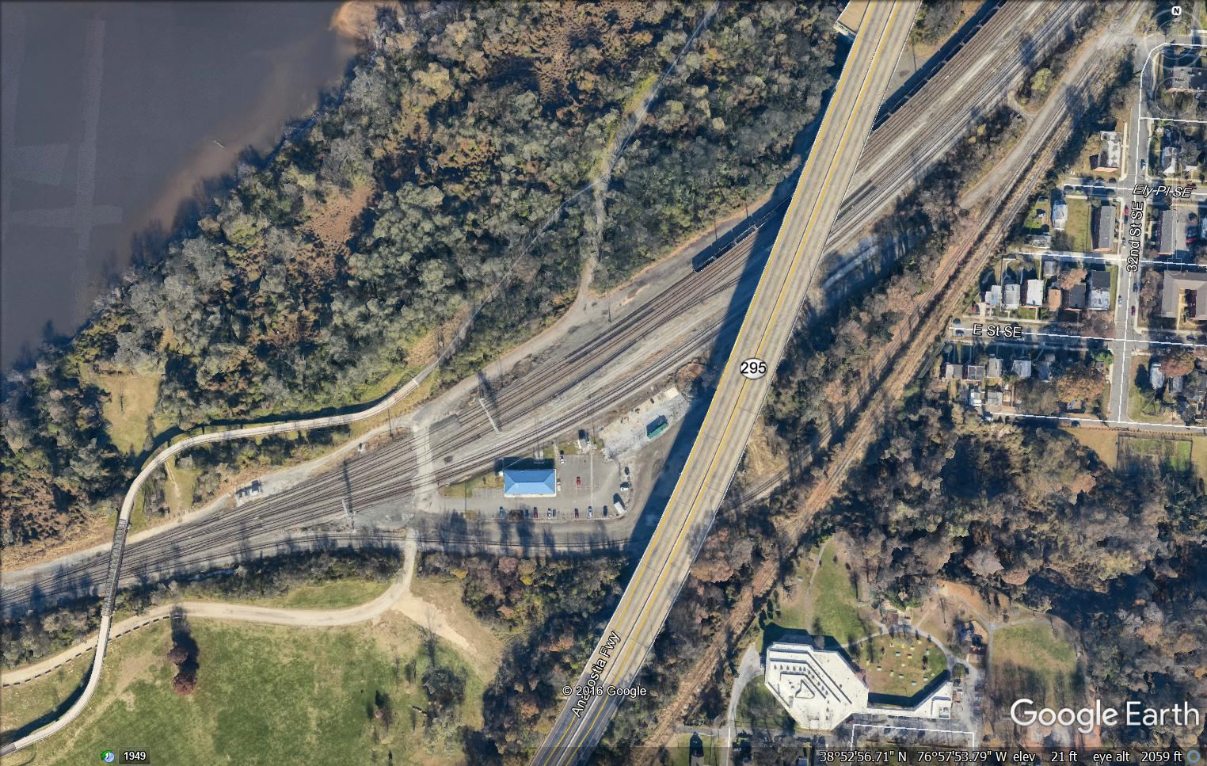
Site Background
Railyard in Washington, DC
> 100-year history
Historic fueling operations result in plume of Diesel Range Organics (DRO’s)
I-295 elevated above tracks
  1957 original
  1988 expansion
Yard office construction and other improvements 2004
General Area of DRO Plume

Slide 3
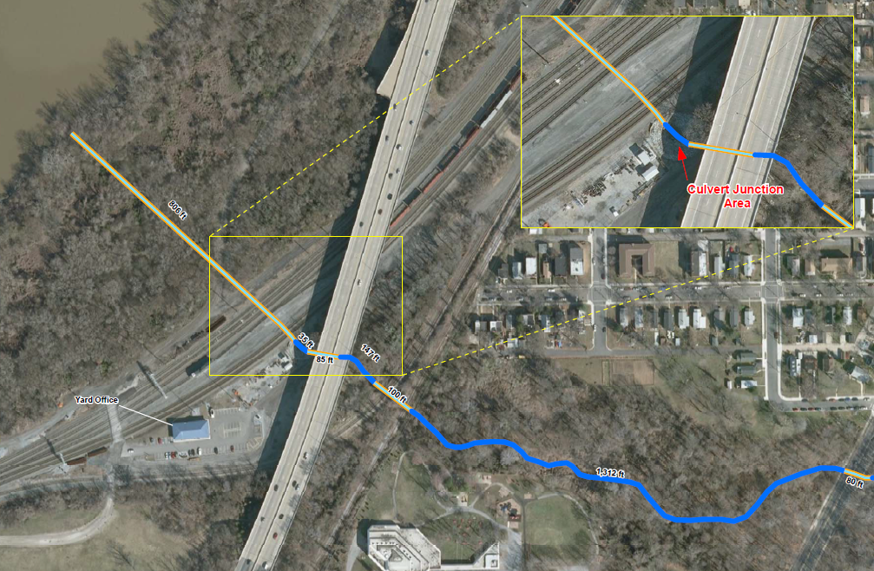
Site Background
Plume was intercepted by the installation of new stormwater infrastructure in 2004
Subsequent inadvertent DRO release to culvert junction area and adjacent creek
Immediate regulatory agency involvement
Commence plume delineation and Corrective Action Plan (CAP)
Creek

Slide 4
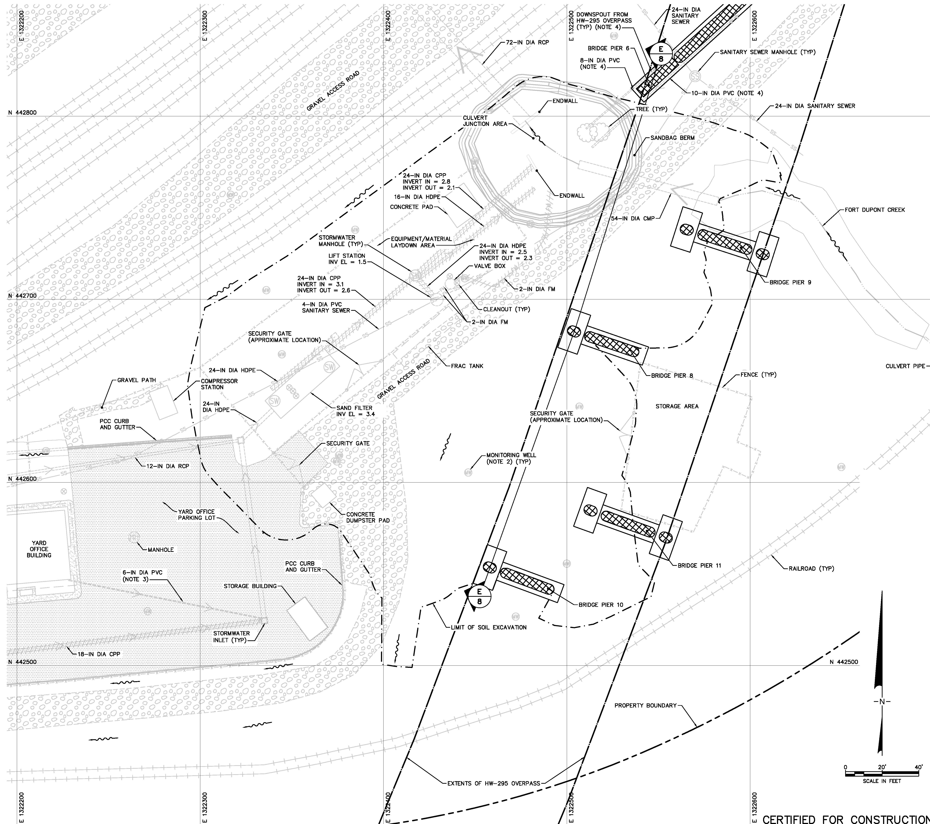
Site Investigation
Environmental investigation to delineate extent of plume
4 I-295 Bridge Piers within the footprint
Geotechnical investigation
    4 Standard Penetration Test Borings
    4 Cone Penetration Tests (CPT’s) Soundings
Pier 9
Pier 8
Pier 10
Pier 11

Slide 5
General Subsurface Profile
Silty Sand Fill
Silty Sand Fill
Low Plasticity Clay
Low Plasticity Clay
Silty Sand
Silty Sand
Very Still Clay
Very Still Clay

Slide 6
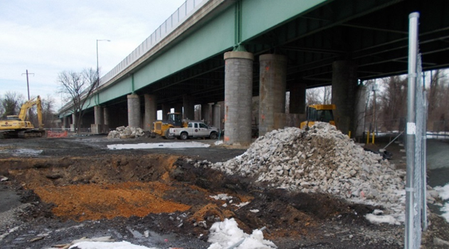
I-295 Bridge Piers
Pier 11
Pier 9
Pier 8
Pier 10

Slide 7
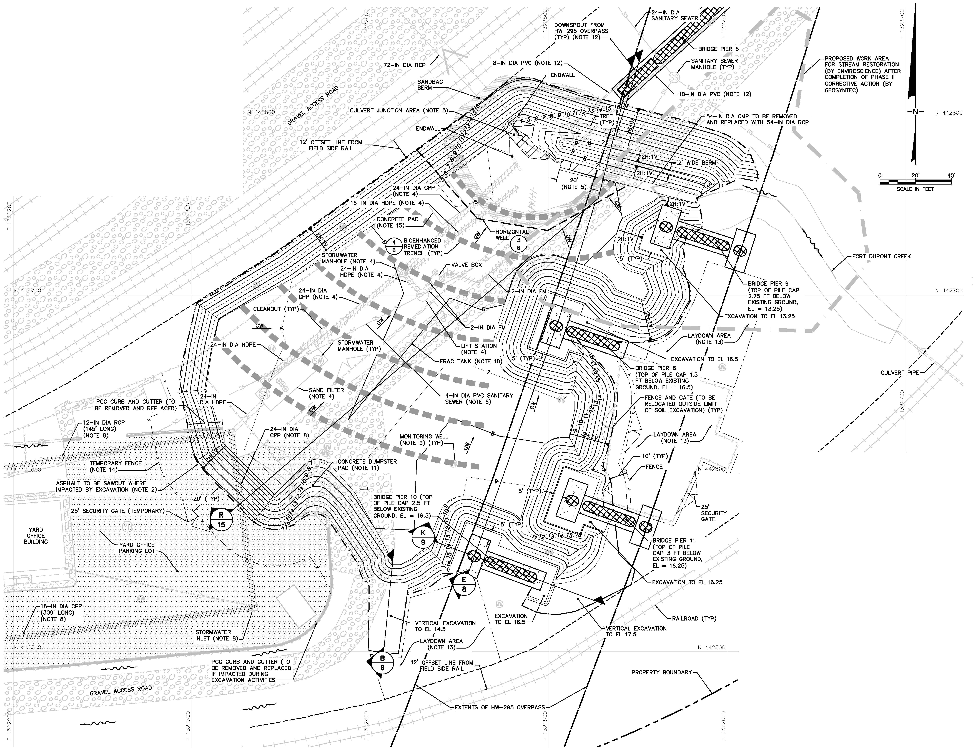
I-295 Bridge Piers & Proposed CAP
Several remedies considered
Excavation and Replacement
Approx 10-12 ft deep
5 ft offset from pile caps
Trans. Agency review and approval

Slide 8
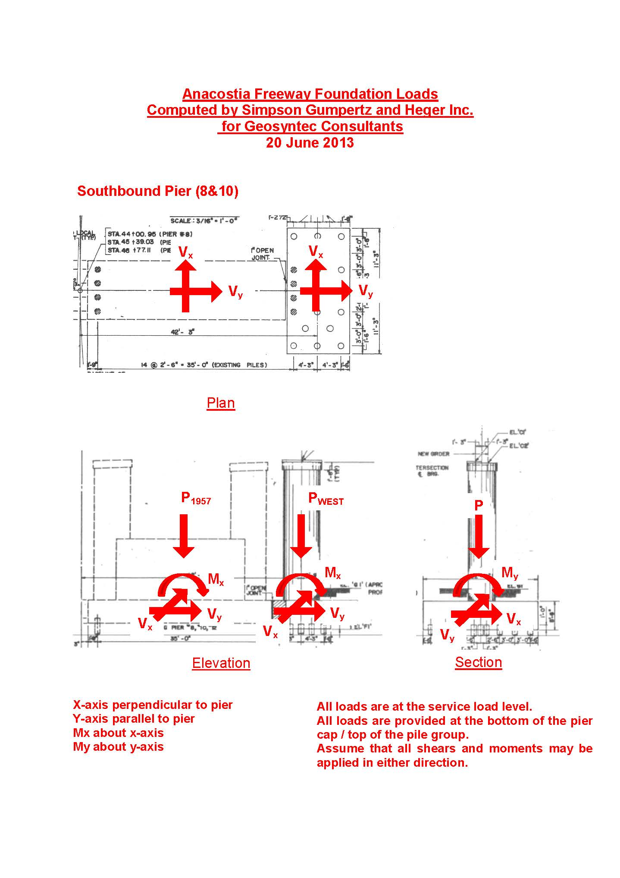
Load Estimation on Bridge Piers
AASHTO 2002 Standard
1957 Bridge Drawings and 1988 Expansion
Piers 8 and 10 have same configuration

Slide 9
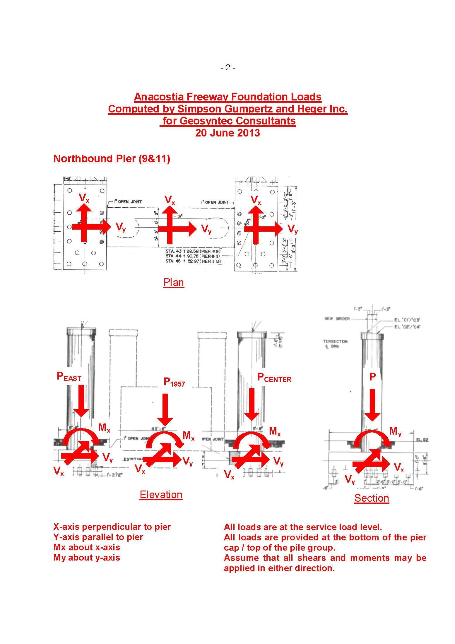
Load Estimation on Bridge Piers
AASHTO 2002 Standard
1957 Bridge Drawings and 1988 Expansion
Piers 9 and 11 have the same configuration

Slide 10
Load Estimation on Bridge Piers (Summary)
Looking at 1988 pile caps directly adjacent to excavation
Max vertical Load = 800 kips
Max transverse (y-direction)
  Toward the excavation = 14 kips
Max parallel (x-direction)
  Direction of vehicular travel = 8 kips
Max overturning moment = 560 kip-ft
Wind directionality at 0 and 30 degree angles to bridge

Slide 11
Pile Group Geometry and Load Distribution
Cast in place concrete piles
Independent groups
1988 group most affected
Loads distributed assuming cap is perfectly rigid
813 k
380 k-ft
14 k
460 k-ft
9 k

Slide 12
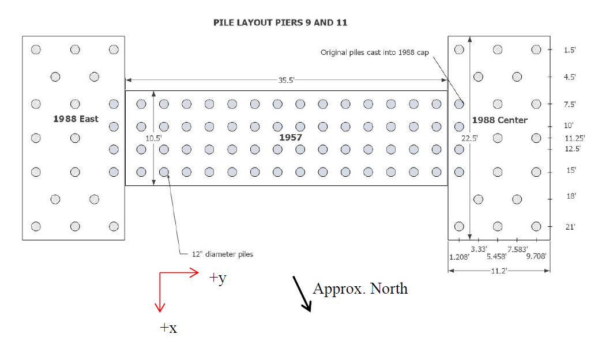
Pile Group Geometry and Load Distribution
Cast in place concrete piles
Independent groups
1988 group most affected
Loads distributed assuming cap is perfectly rigid
840 k
421 k-ft
15 k
558 k-ft
9 k

Slide 13
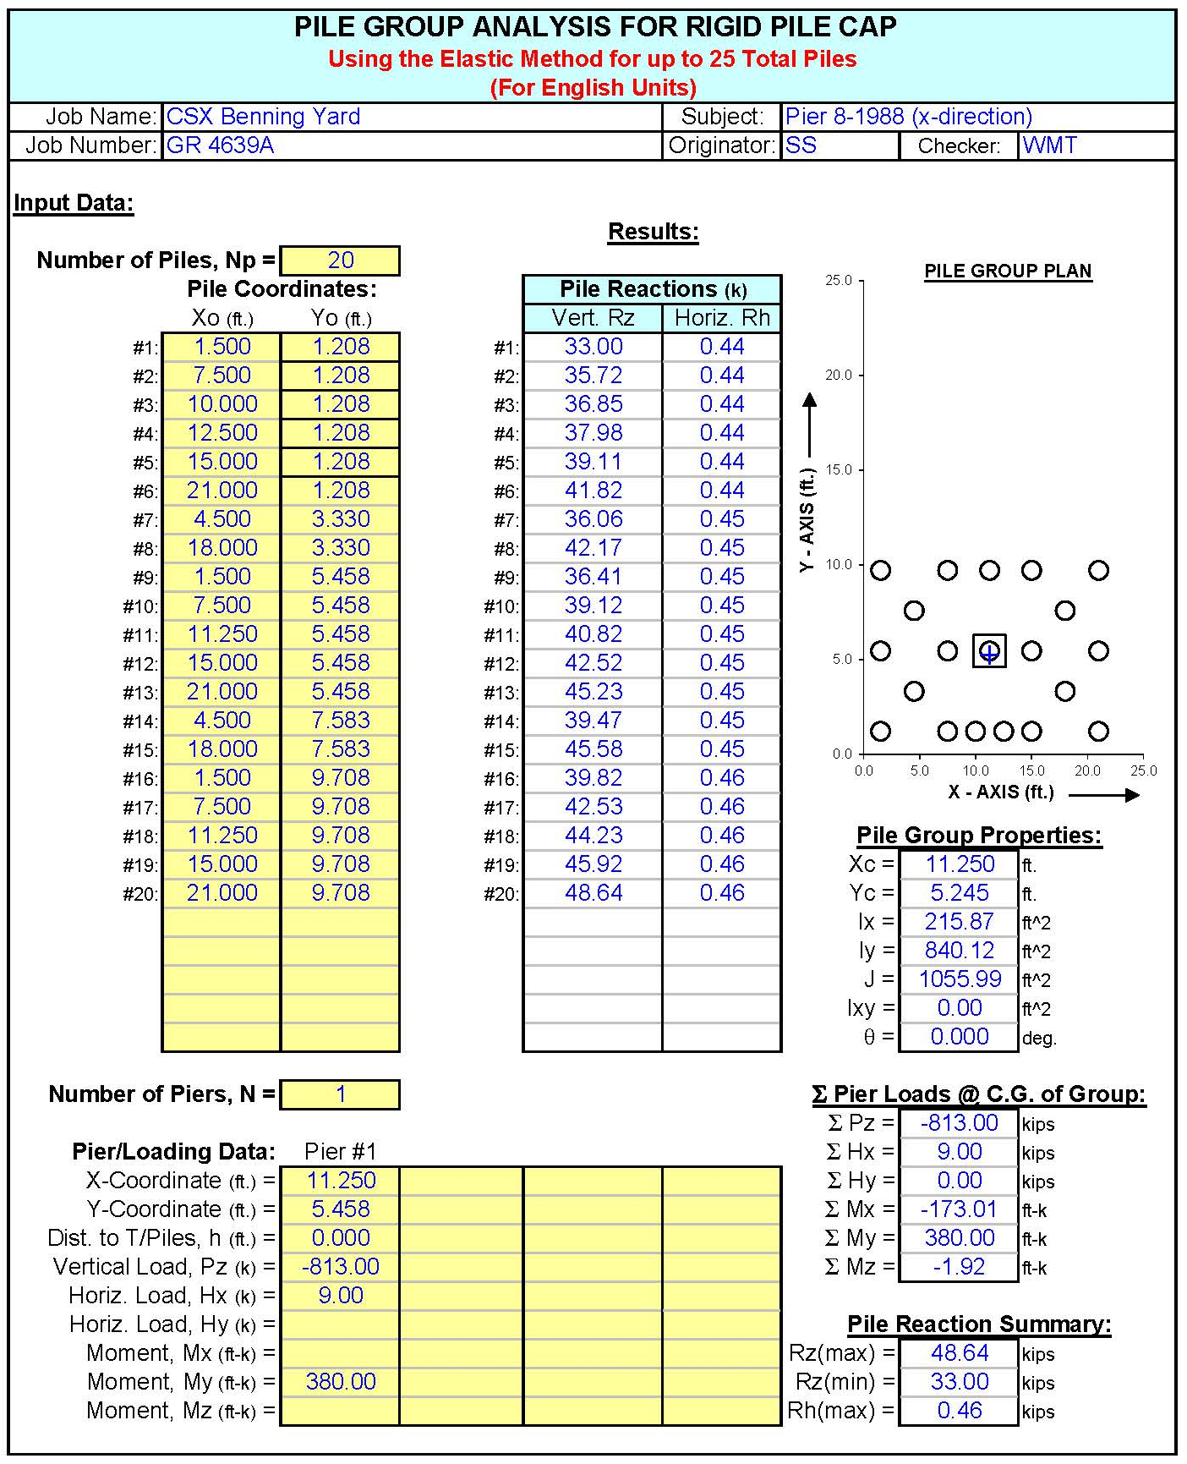
Pile Group Geometry and Load Distribution
Apply loads evenly across cap
Superposition
Rigid cap
PILEGRP
Resolve loads to single pile
Ready for Lpile!

Slide 14
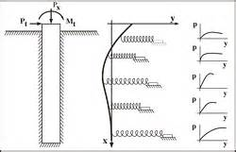
Lateral Load Analysis
Iterative finite difference computational approach implemented in Lpile
Use of pile-soil-pile modifiers to simulate group behavior
Two overall approaches
  Forward solution using resolved structural loads
  Inverse solution using target max. deflections of 0.25 inches (limit)

Slide 15
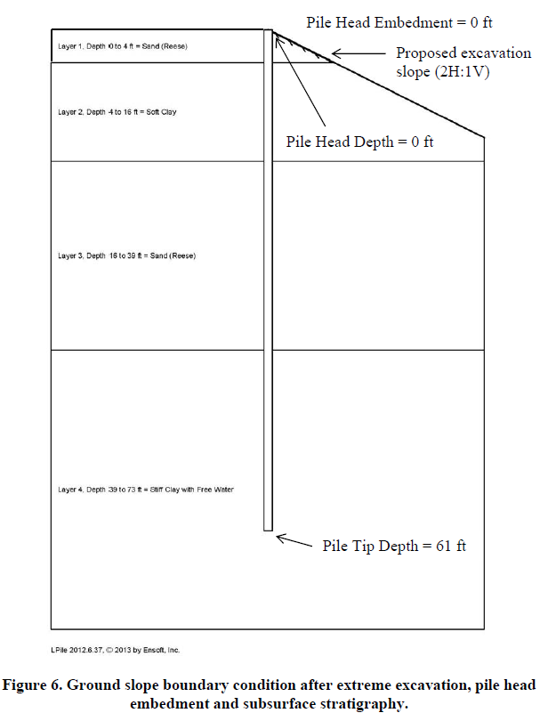
Lateral Load Analysis
Reese Sand
D = 4ft
Selected p-y models
Parameters based on mix of lab data and literature values
Pile Properties
  12 in dia.
  “CIP” piles
  Resteel cage 4 #6’s
Soft Clay
D = 16ft
Reese Sand
D = 39ft
Stiff Clay
D = 73ft

Slide 16
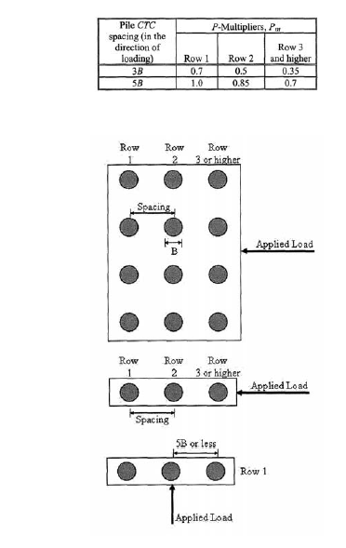
Lateral Load Analysis - Forward
Single pile analysis
P-multiplier = 0.7 (AASHTO 2010) for leading row
Pier 8 (x-direction)
  Axial load = 48.64 kips
  Lateral load = 0.46 kips
  Calculated deflection = 0.06 in.
Pier 9 (x-direction)
  Axial load = 50.58 kips
  Lateral load = 0.46 kips
  Calculated deflection = 0.02 in.

Slide 17
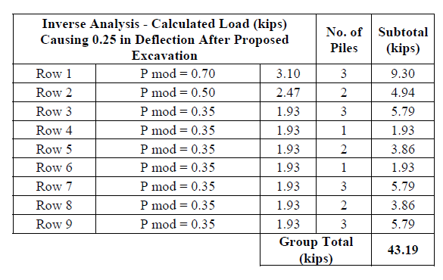
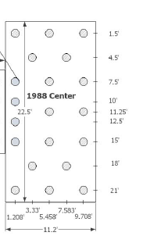
Lateral Load Analysis – Inverse
Deflection threshold for entire group = 0.25 in
Pier 9
9 k applied

Slide 18
Conclusions and Recommendations
Calculations demonstrated minor deflections are expected as a result of the excavation
Inverse analysis demonstrated that the load required to move an entire pile group 0.25 inches is an order of magnitude larger than the applied load
Both approaches indicated little concern
However the bridge structure is a critical part of DC traffic conveyance
Recommend pre and post construction condition assessments
Construction monitoring program

Slide 19
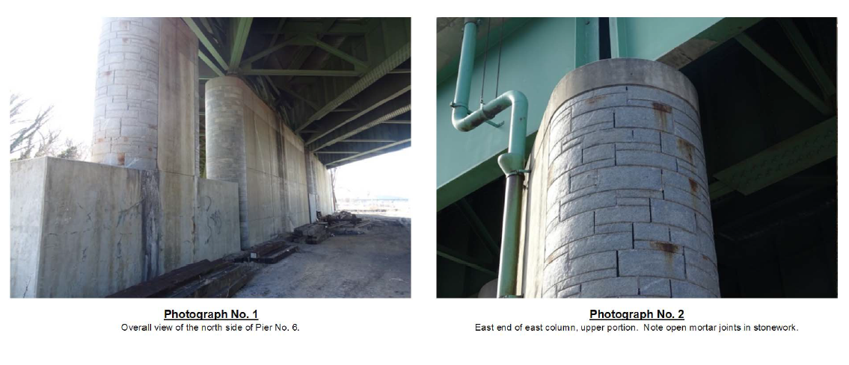
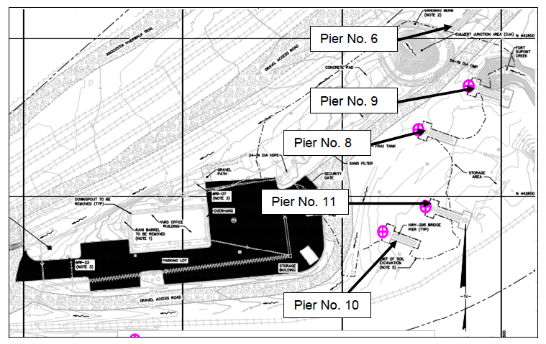
Pre-Construction Condition Assessment

Slide 20
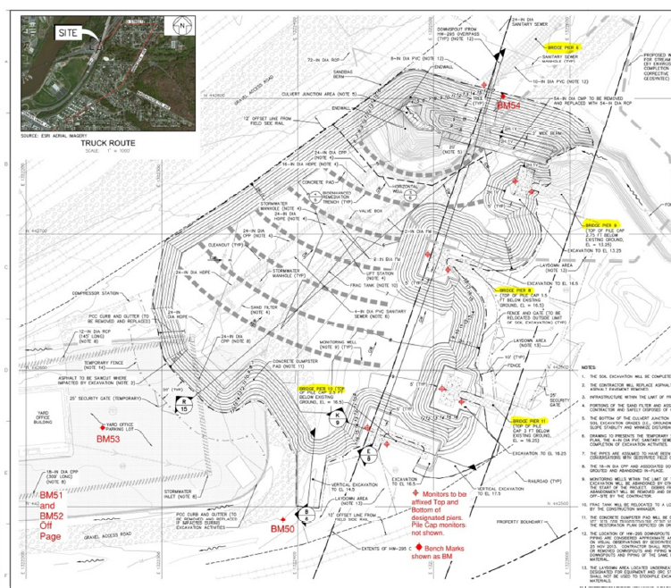
Monitoring Program
Threshold value = 0.25 in
  If exceeded, increase frequency of monitoring
Limit value = 0.50 in
  Stop work if reached
  Notify agency
  Immediately place fill in excavation

Slide 21
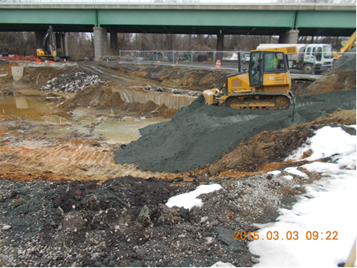
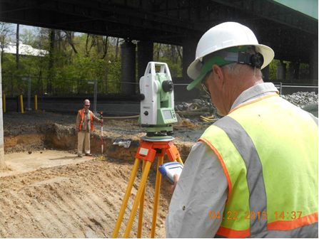
Construction
Excavation near Pier 9
Survey at Pier 9 pile cap

Slide 22
Monitoring Program - Results
No discernable movement trends detected
System “noise” of about 0.15 inches
No threshold exceedance
No limiting value exceedance

Slide 23
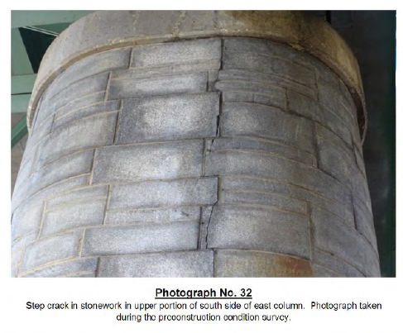
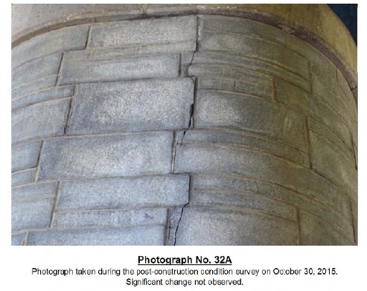
Post Construction Condition Assessment
No additional distress observed on the inspected bridge elements (piers, bearings, girders, decking, etc.)
Before
After

Slide 24
Questions
Thank you!
Questions?

